Slide 1
Fitness Finder
01
02
03
Overview
Fitness Finder is a app that combines all Fitness related items in one place.
Made By
Jacqueline Kolze & Savannah Niemeyer
What it does
This app eliminates the need for multiple fitness apps, it creates a all in one experience for the user.

Slide 2
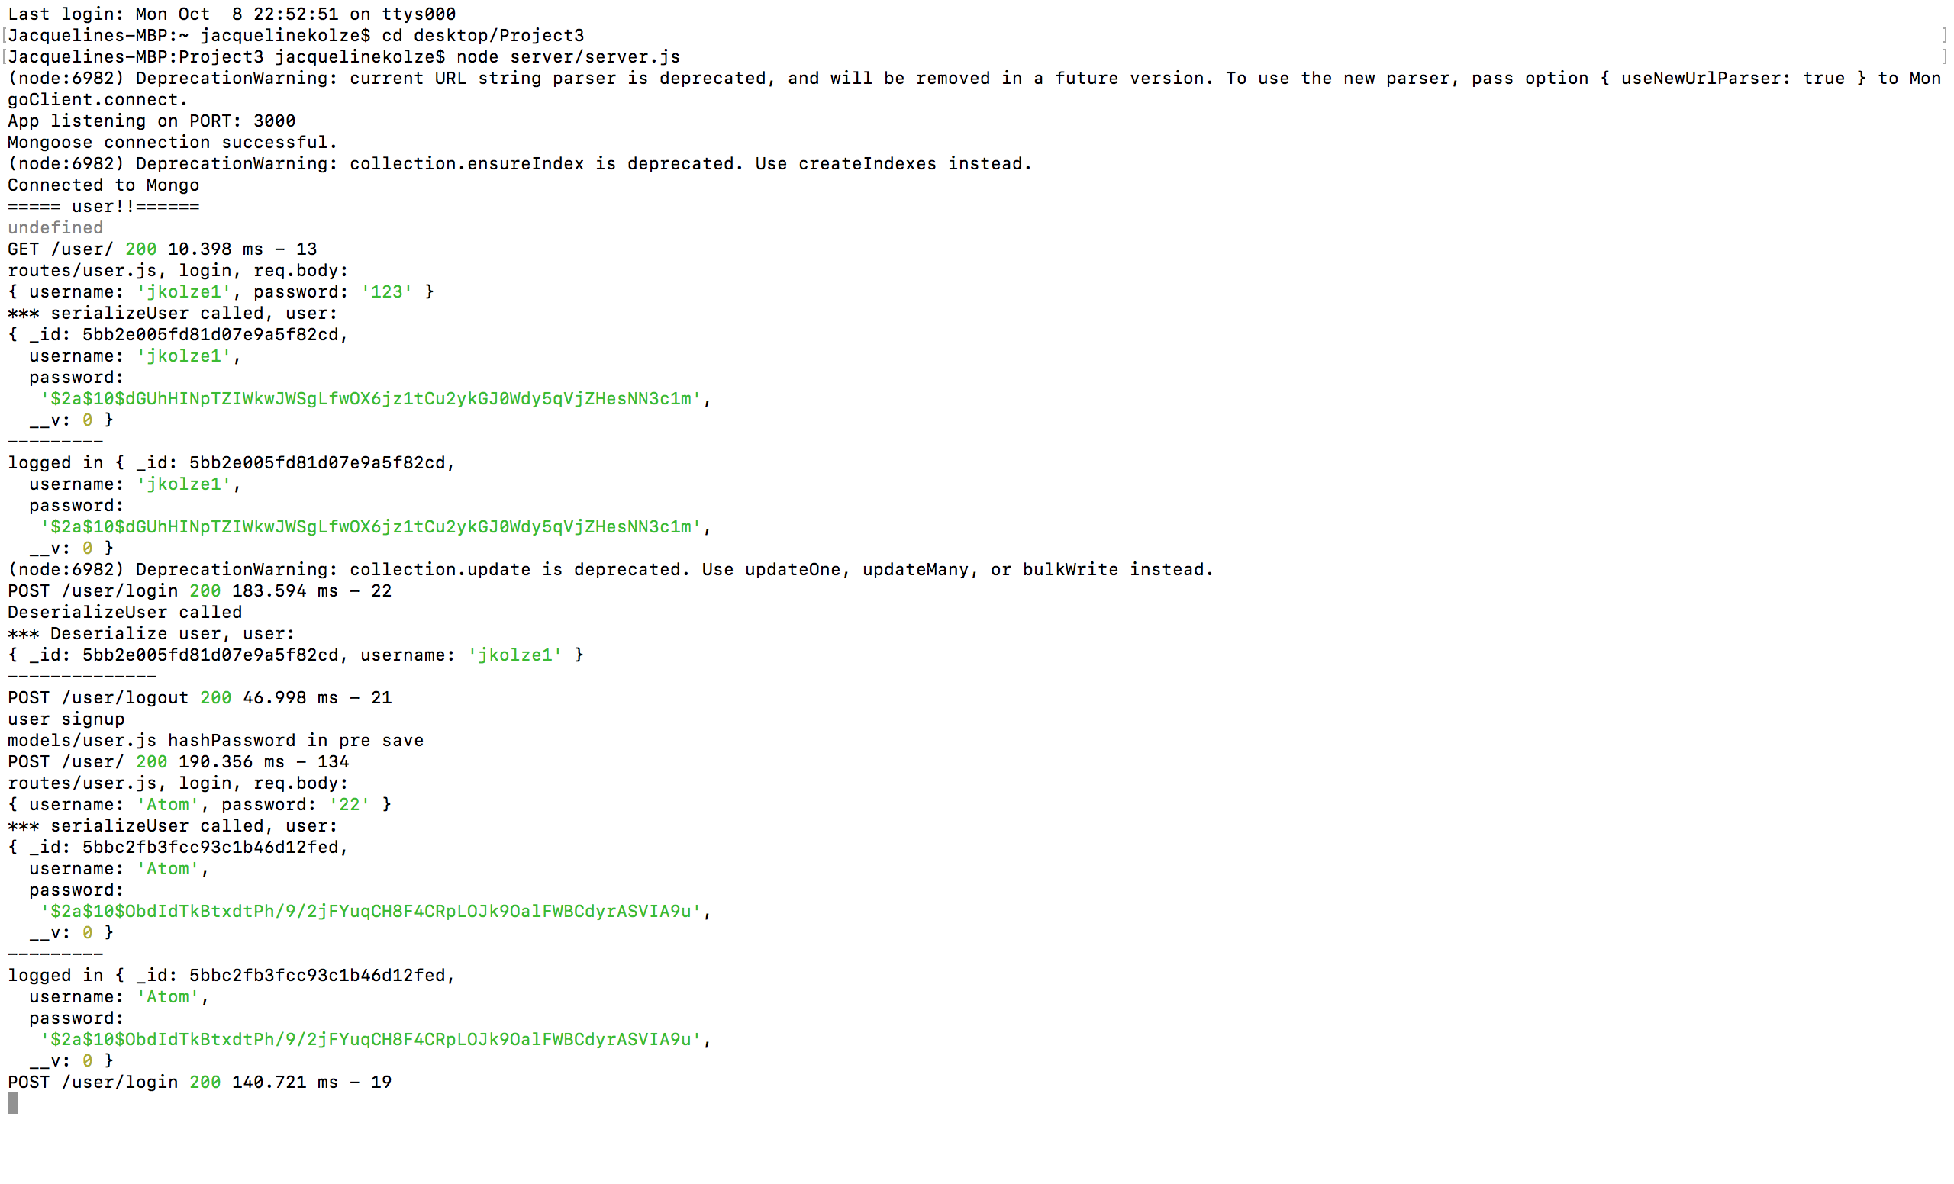
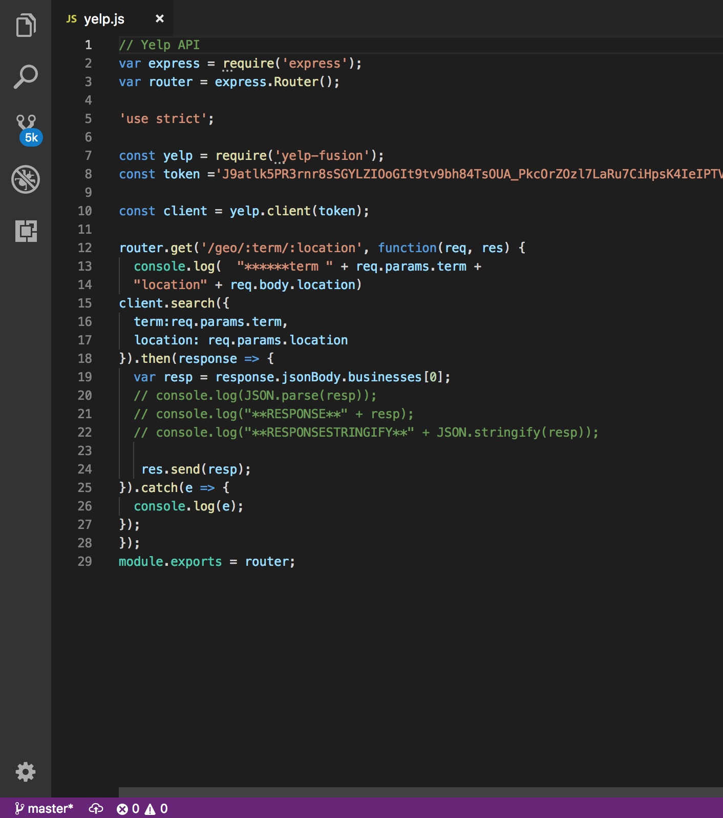
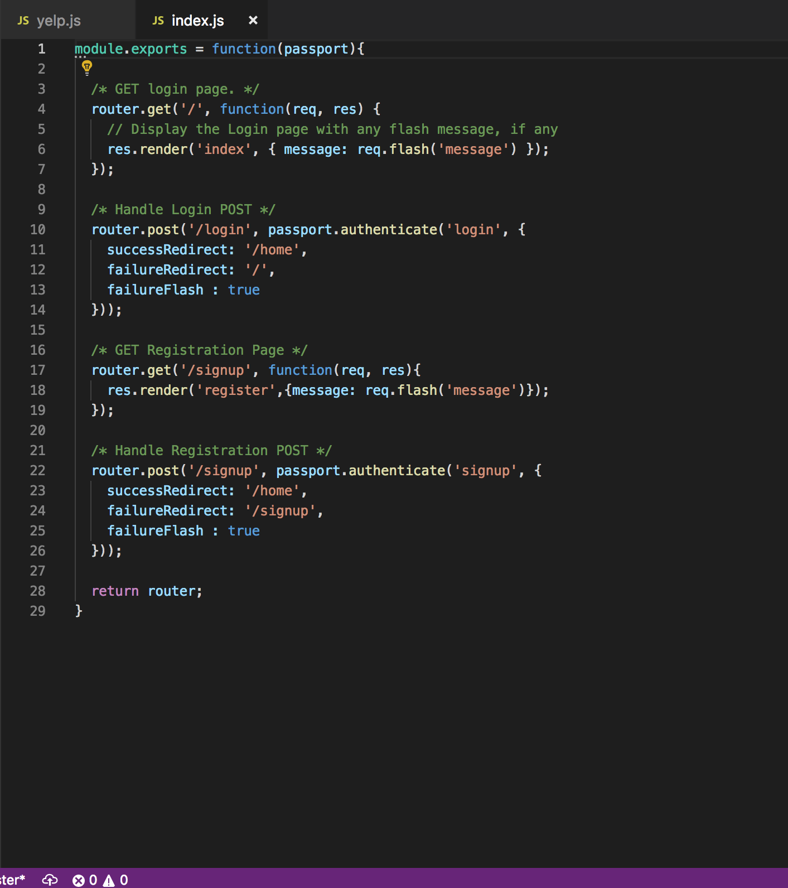
Backend
Tools used
For the login/Sign up component I used Passport for authentication, mongo DB to store user info, and Brycpt to hash out sensitive materials.
API’s Used
I used Yelp-fusion, Google Maps, and Active API. Yelp and Google Maps are for finding new trails and parks, While the Active API is for all health related things.

Slide 3
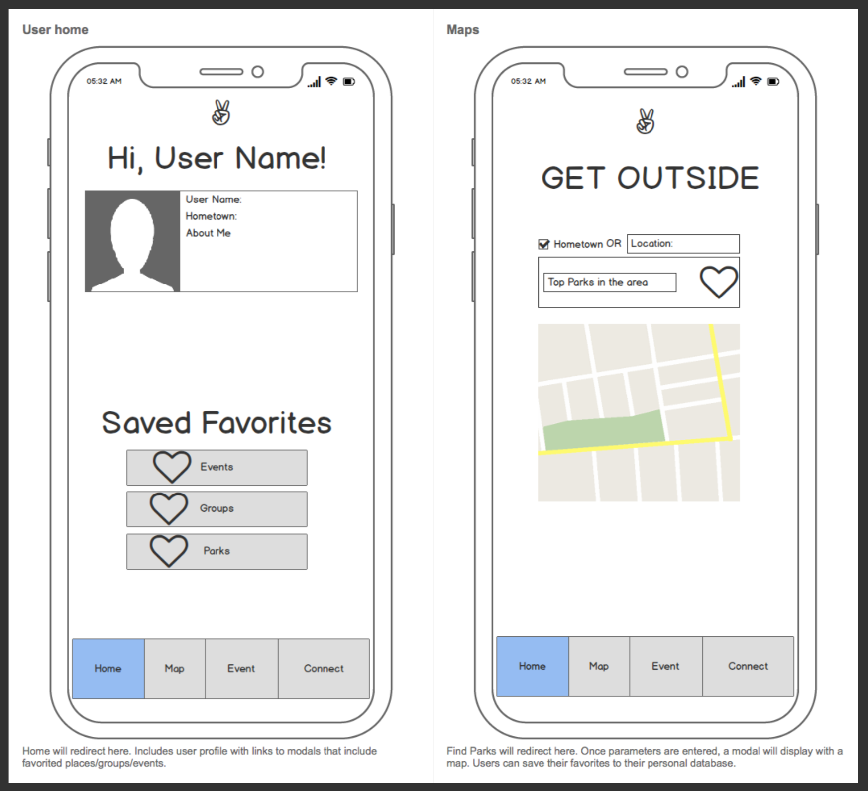
Front End

Slide 4
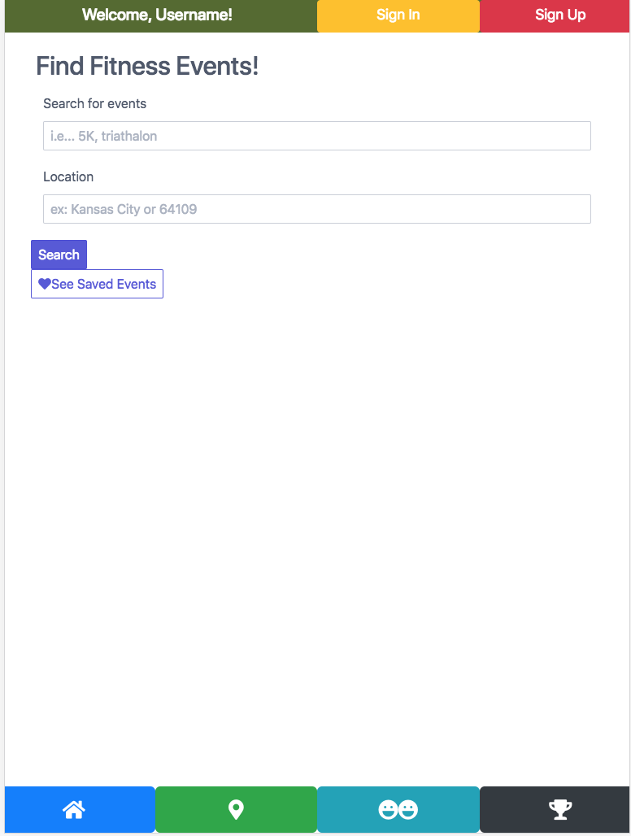
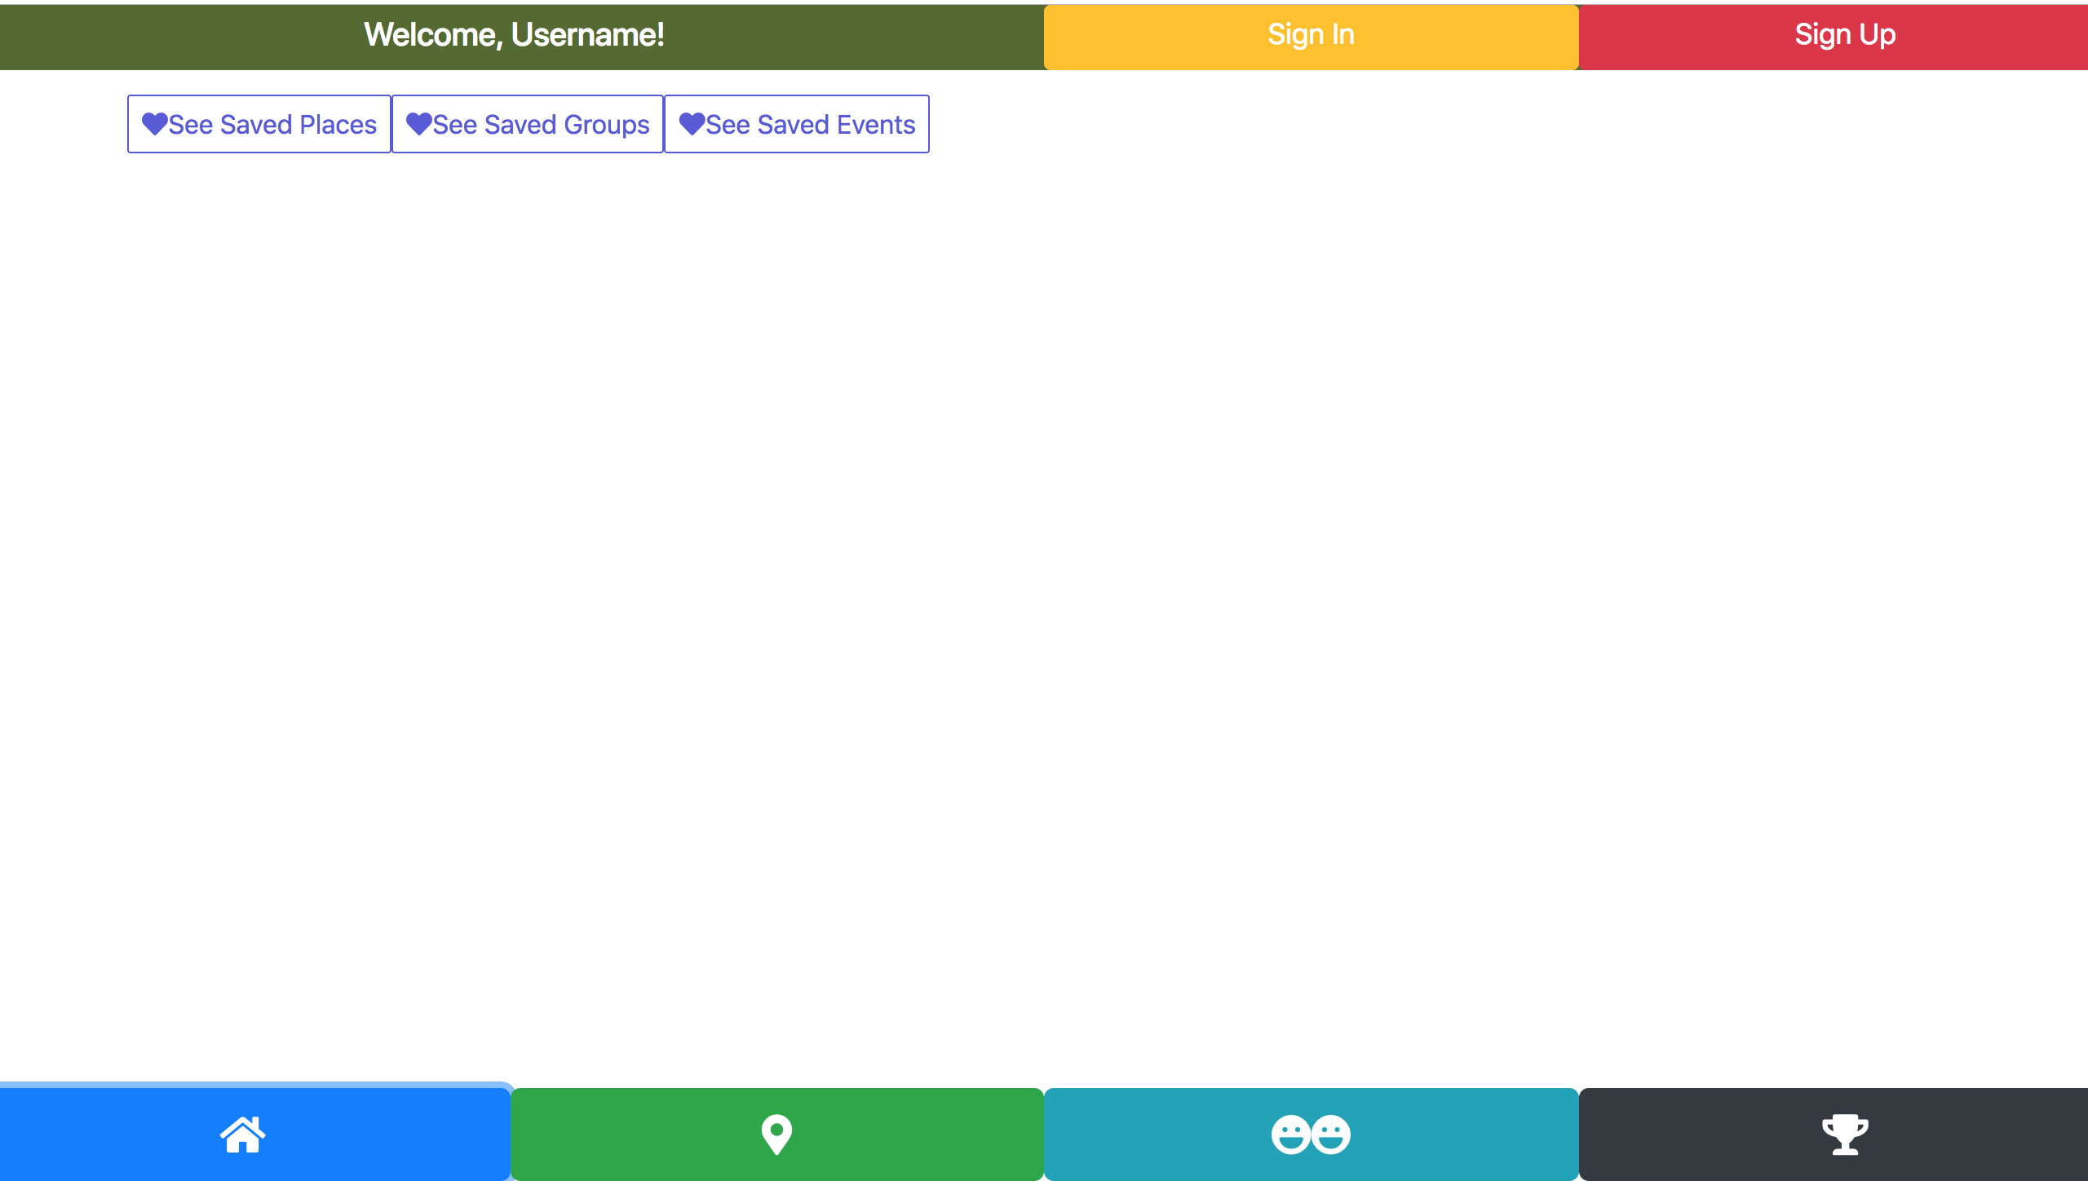
Layout

Slide 5
API’s
-Google Maps
-Yelp Fusion
-Meetups API
-Originally we tried to use the Active API, that did not work out though, this is because it had not been updated since 2015.

Slide 6
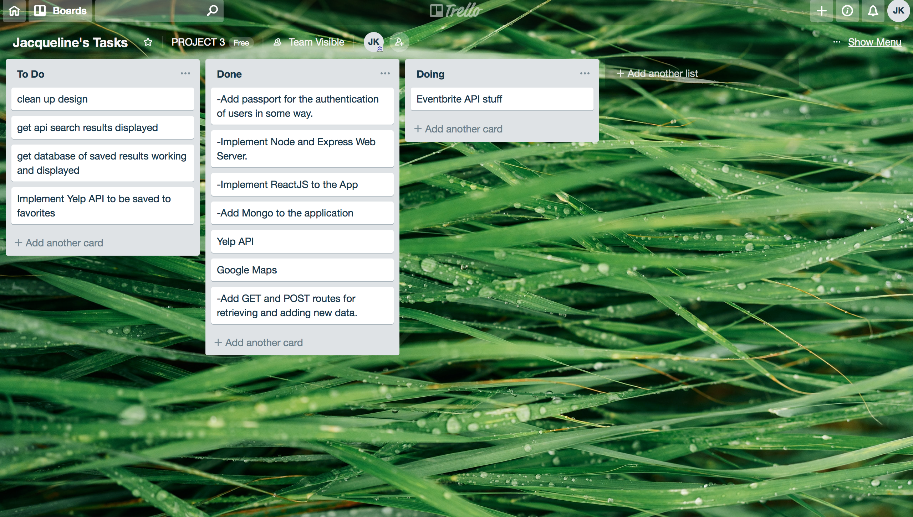
Trello Board!

Slide 7
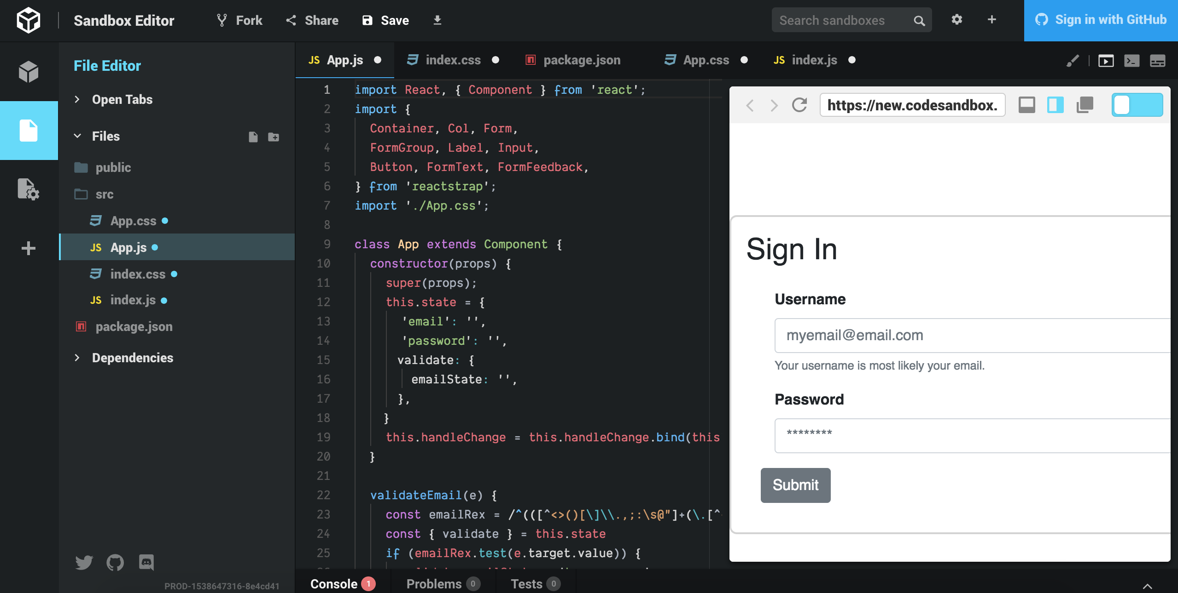
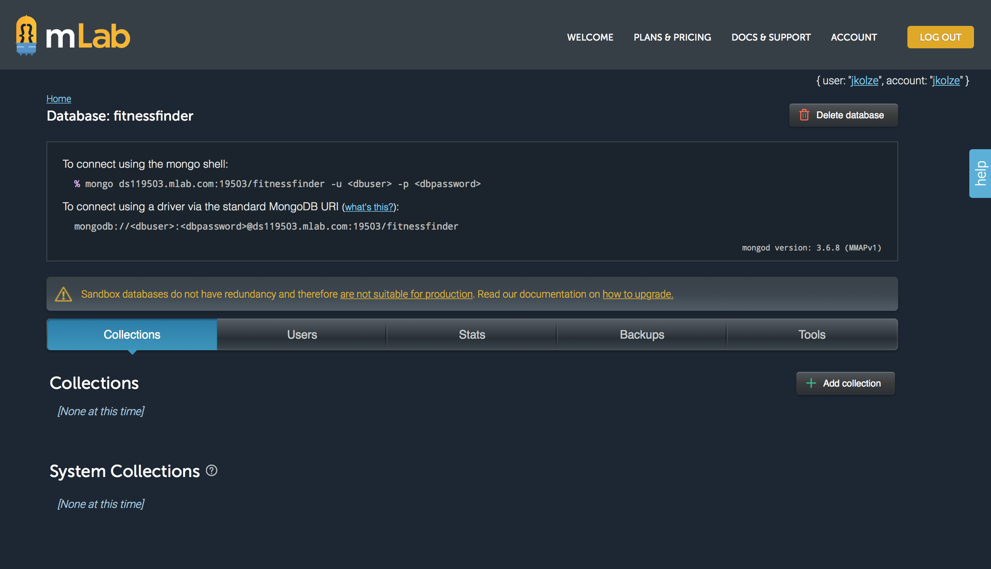
Other tech we used

